Slide 1
Frames Pictures

Slide 2
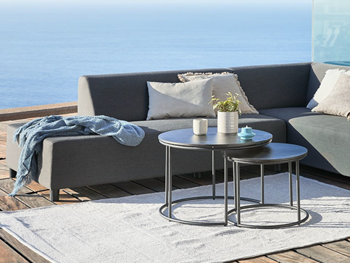
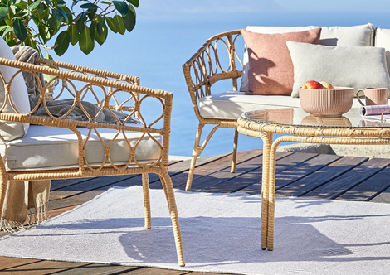
Place: 1.2.45
X 1
180559
180594
181834
180629

Slide 3
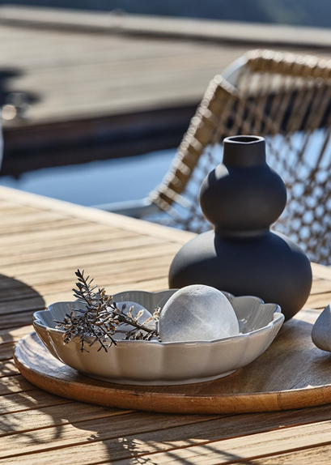
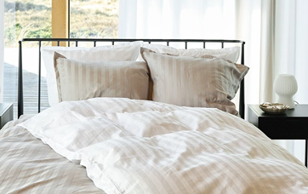
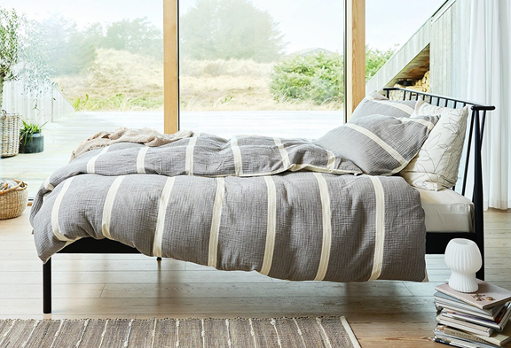
Place: 1.3.21 + 2.3.06
X 2
180679
184902
186299
184898

Slide 4
Place: 1.3.23 + 2.2.05
X 2
189136
192788
192790

Slide 5
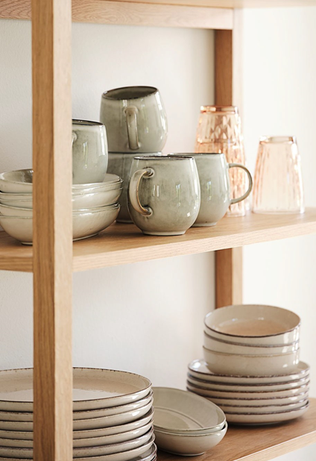
Place: 1.3.23 + 2.2.05
X 2
189073
192773
192780

Slide 6
Place: 2.2.04
X 1
192801
192800
189346

Slide 7
Place: 1.2.42
X 1
181646
181872
181647

Slide 8
Place: 1.3.21
X 1
189300
189305
189310

Slide 9
Place: 2.2.02
X 1
180620
180555
180625

Slide 10
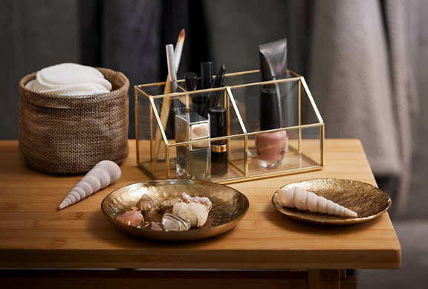
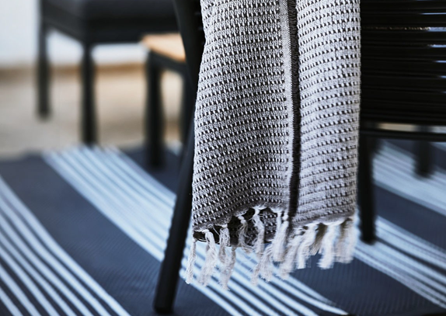
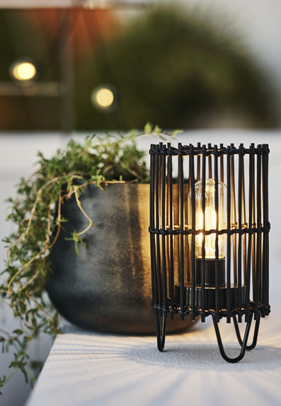
Place: 1.3.21 + 2.3.06
X 2
193374
192831
180572
180573

Slide 11
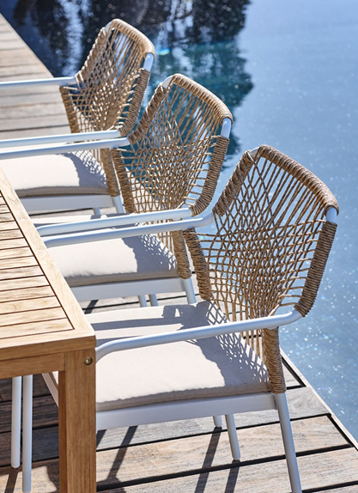
Place: 2.2.02 + 2.3.02
X 2
181834
180686

Slide 12
Place: 2.2.04
X 1
180690
180691
181834

Slide 13
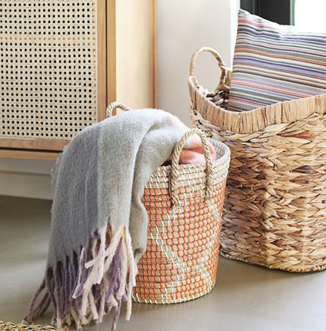
Place: 2.3.05
X 1
189094
189082
192780

Slide 14
Place: 1.3.23
X 1
189351
189353
189354

Slide 15
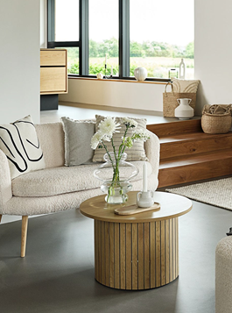
Place: 2.2.01
X 1
192798

