Slide 1
How to add your own text and photo

Slide 2
Overview
Templates
How to change TEXT
Requirements for your photo
How to change PHOTO

Slide 3





Templates
Templates can be found here:Picture templates - HR - Global Site (jysk.com)
There is 5 different templates you can choose from:

Slide 4
How to change TEXT
All text is editable, so change the text by clicking on the text fields
If you need more space for your local text:
  You can decrease the font size or make the text fields bigger, in the situations where it is possible.
    Please be aware the text need to be quite big to ensure readability on mobile view.

Slide 5
Requirements for your photo
Always take a photo with the person in the middle of the frame
Always use a calm background – preferable a white one.
The picture should be sharp and in good quality

Slide 6


How to change PHOTO
In the PowerPoint there is a layout mockup and a template you are able to work in
Layout mockup
Template

Slide 7
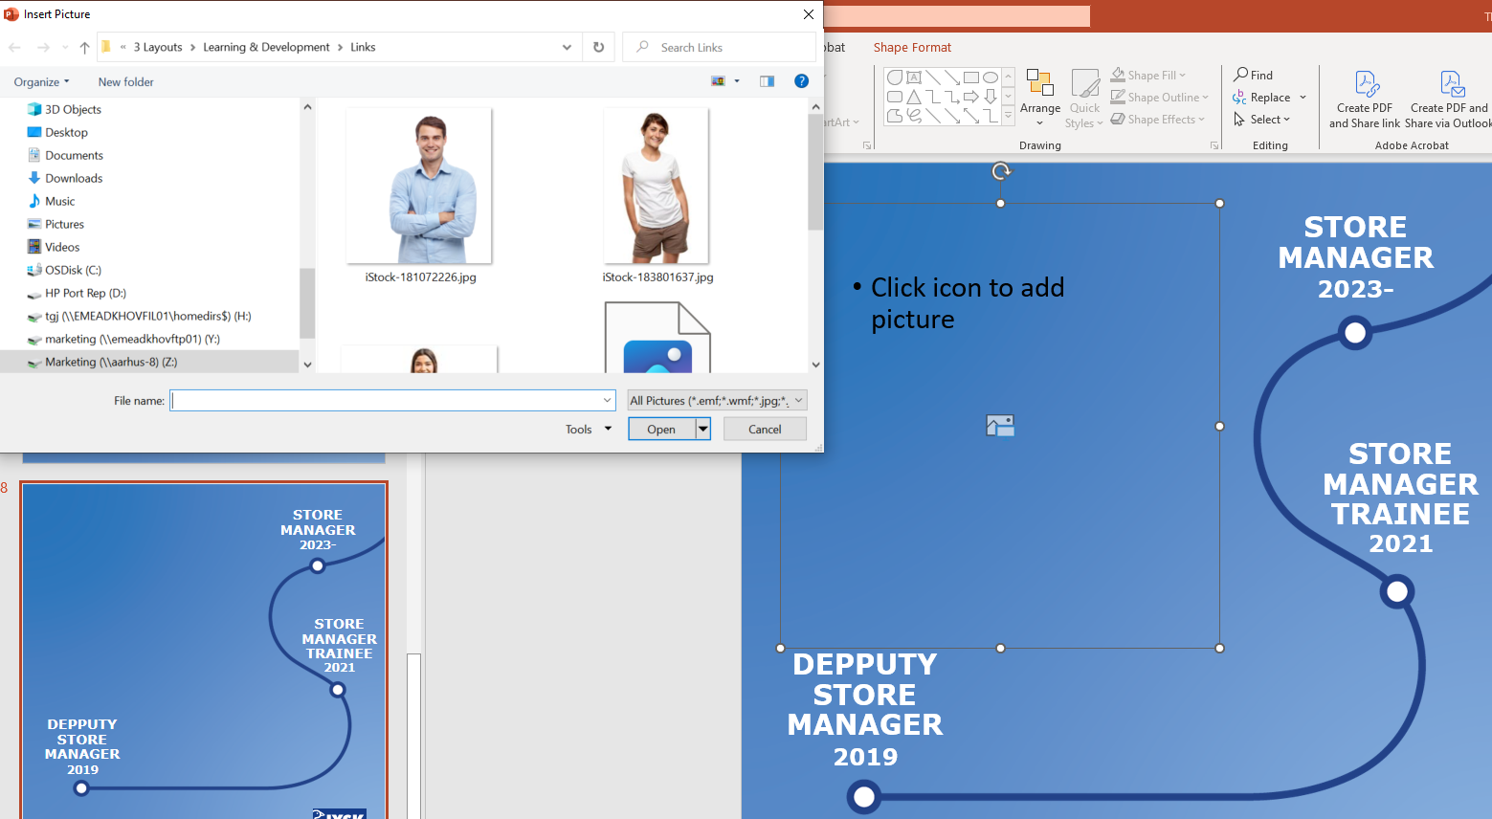
How to change PHOTO
Click on the Picture placeholder on the template
Find the photo you want to use

Slide 8
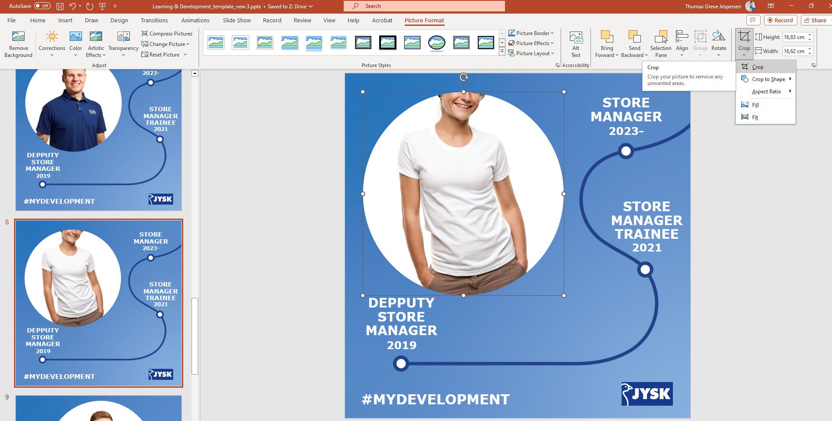
How to change PHOTO
If the photo does not fit, click on the crop button and choose “crop”

Slide 9



How to change PHOTO
Then you will get the opportunity to move the photo in the picture placeholder(step1)
Move the photo so it fits into the picture placeholder(step 2)
When your photo is placed like you want, click anywhere outside of the photo (step 3)
Step 1
Step 2
Step 3

Slide 10
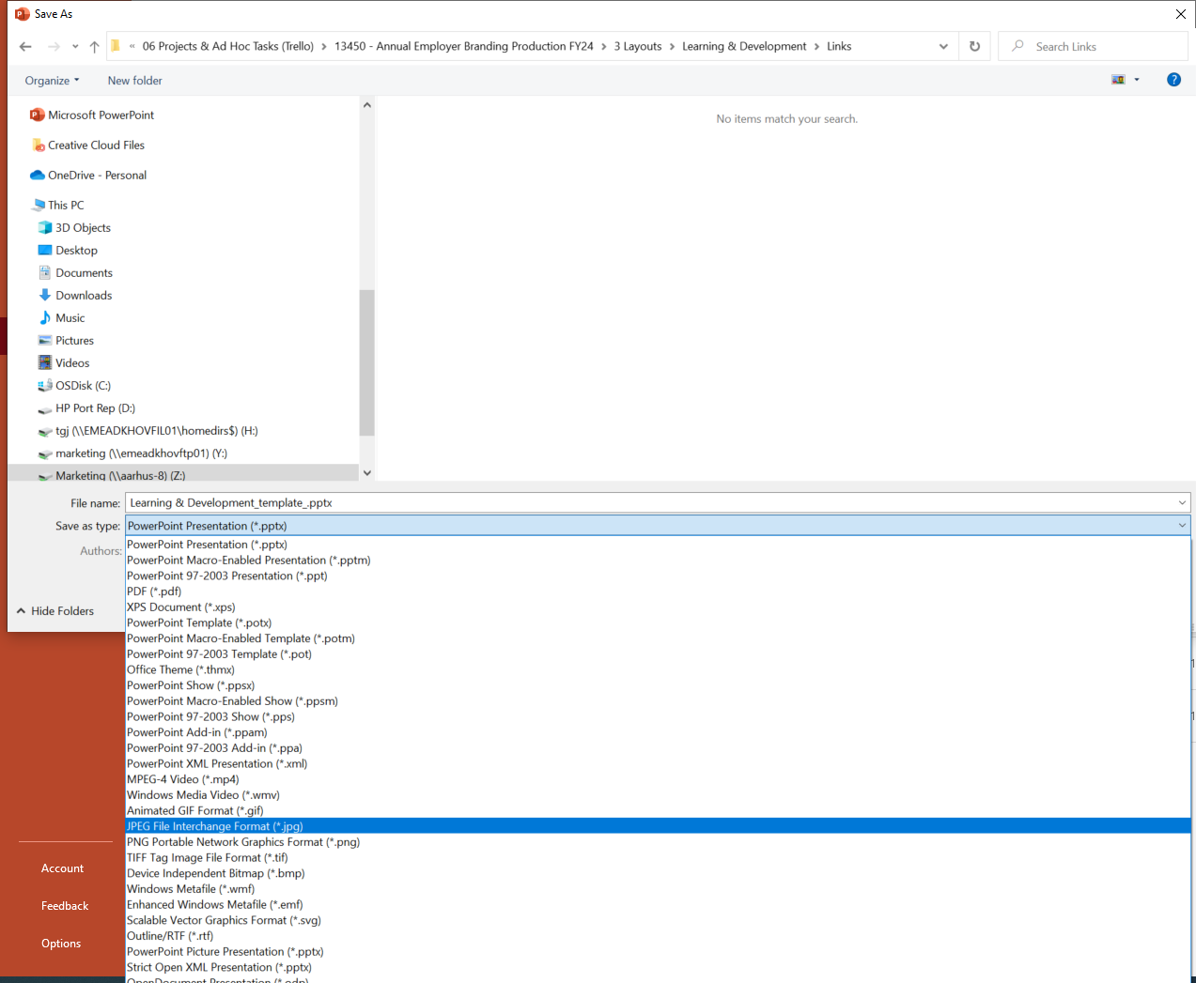
SAVE a JPEG
Now the template is ready.
Then save it as a JPEG to use it on SoMe.

